Slide 1


CE141: COMPUTER CONCEPTS & PROGRAMMING
July – November 2018
Chapter – 1
Introduction to Computation
Devang Patel Institute of Advance Technology and Research

Slide 2


Objectives
To understand basic terms of Computer
To understand about Program and its Execution
To understand about various components of Computer
To understand about Software and Hardware
To understand about types of software
Chapter – 1 : Introduction to Computation

Slide 3
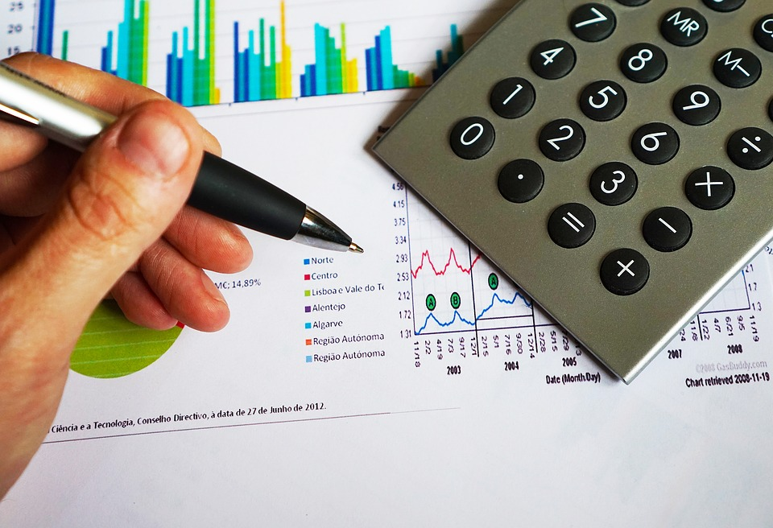
Computation
Chapter – 1 : Introduction to Computation

Slide 4
Computer
Derived from word “Compute”
Electronic device that can store, process and retrieve data according to instruction
Chapter – 1 : Introduction to Computation

Slide 5
Instruction
Order given to a computer processor by a computer program
Single operation of a processor defined by the processor instruction set
Example : sum = a + b;
Chapter – 1 : Introduction to Computation

Slide 6
Program
Set of instruction in a logical order to perform a meaningful task
Usually written by computer programmer in a programming language
Chapter – 1 : Introduction to Computation

Slide 7
Example of Program
#include<stdio.h>
int main()
{
int n1, n2, sum;
printf("Enter two numbers to add\n");
scanf("%d %d", &n1, &n2);
//Addition of Two numbers
sum = n1 + n2;
printf("Sum of the numbers = %d\n", sum);
return 0;
}
Chapter – 1 : Introduction to Computation

Slide 8
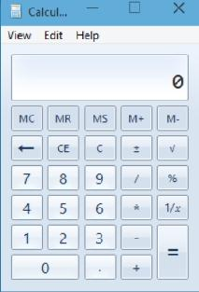
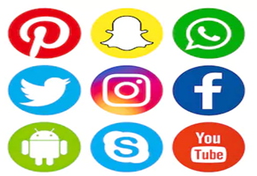
Software
Set of programs with GUI
Part of a computer system that consists of data or computer instructions
Chapter – 1 : Introduction to Computation

Slide 9
Data
Information processed or stored by a computer
Alphabets (A-Z, a-z), Digits (0-9) or Special characters (+,-,/,*,<,>,= etc.)
Example – Values of a and b in sum program
Chapter – 1 : Introduction to Computation

Slide 10

File
Object on a computer that stores data, information, settings, or commands used with a computer program
In a GUI such as Microsoft Windows, files display as icons that relate to the program that opens the file
Chapter – 1 : Introduction to Computation

Slide 11
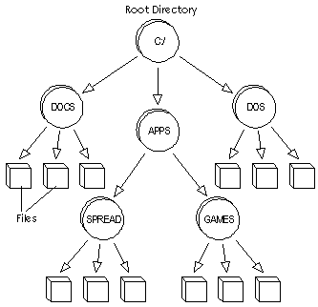
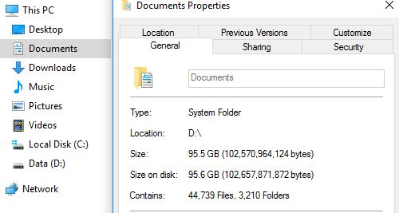
Directory
File system cataloging structure which contains references to other computer files, and possibly other directories
Chapter – 1 : Introduction to Computation

Slide 12
Libraries
Inbuilt functions in programming
Examples : stdio.h, conio.h, time.h etc.
Prototype and data definitions of the functions are present in their respective header files, and must be included in your program to access them
Chapter – 1 : Introduction to Computation

Slide 13
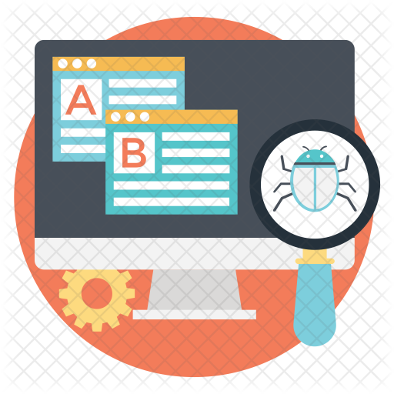
Test
Checkpoints in the overall process to determine whether objectives are being met
Testing purpose is to find bug
Example – Answer of sum is wrong in Add Program
Chapter – 1 : Introduction to Computation

Slide 14

Debug
Identifying problem and the source of the problem
Either correcting the problem or determining a way to work around it
Example – No Answer in Add Program because you have only passed 1 number
Chapter – 1 : Introduction to Computation

Slide 15
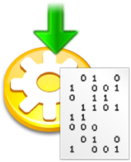
Compilation
Process of converting statements of particular programming language into machine language or "code" that a computer's processor uses
Chapter – 1 : Introduction to Computation

Slide 16
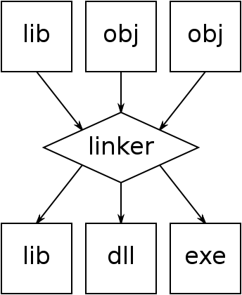
Linking
Process of taking some smaller executable and joining them together as a single larger executable
Chapter – 1 : Introduction to Computation

Slide 17
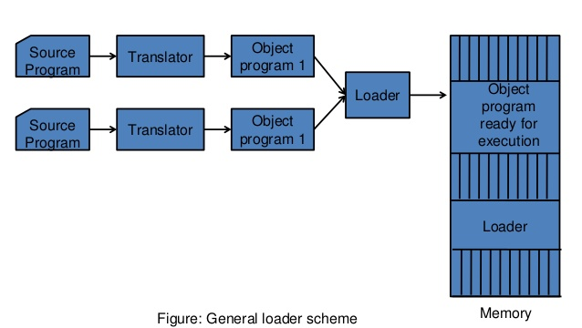
Loading
Loading the executable into memory prior to execution
Chapter – 1 : Introduction to Computation

Slide 18

Execution
Process by which a computer or a virtual machine performs the instructions of a computer program
Instructions in the program trigger sequences of simple actions on the executing machine
Chapter – 1 : Introduction to Computation

Slide 19
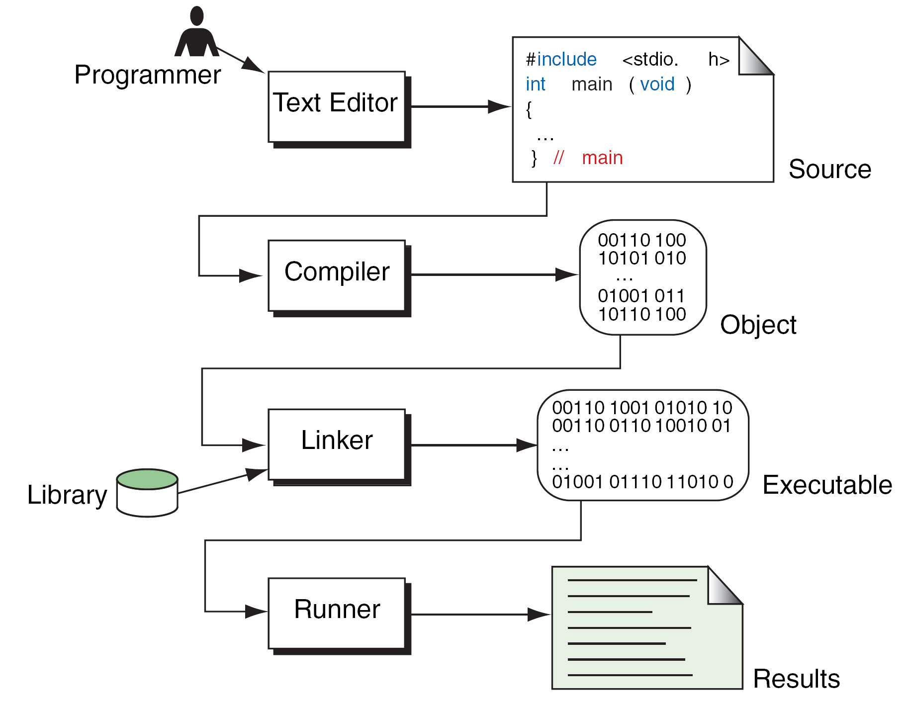
Program Flow
Chapter – 1 : Introduction to Computation

Slide 20
Types of Computer
Categorized on the basis of size, speed and performance
Larger the system, the greater is its processing speed, storage capacity, cost and ability to handle large number of devices
Chapter – 1 : Introduction to Computation

Slide 21
Types of Computer
Microcomputers
Personal computers
Minicomputers
Mainframes
Super computers
Chapter – 1 : Introduction to Computation

Slide 22
Microcomputers
Widely used & fastest growing computers
cheapest among the other types
Specially designed for general usage like entertainment, education and work purposes
Chapter – 1 : Introduction to Computation

Slide 23
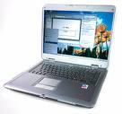

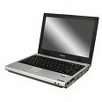
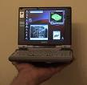
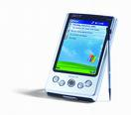
Microcomputers
Desktop
Notebook
Laptop
Subnotebook
Palmtop
Chapter – 1 : Introduction to Computation

Slide 24
Personal Computers
Single user oriented and general purpose microcomputer
Can perform a diverse range of functions, from keeping track of household accounts to keeping records of the stores of a large manufacturing company
Chapter – 1 : Introduction to Computation

Slide 25
Minicomputers
Used by small businesses & firms
“Midrange Computers” and Not designed for a single user like Production department can use Mini-computers for monitoring certain production process
K-202, Texas Instrument TI-990, SDS-92
Chapter – 1 : Introduction to Computation

Slide 26
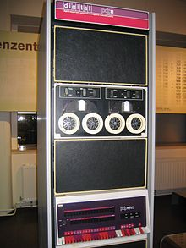
PDP – 11 (Minicomputer)
Chapter – 1 : Introduction to Computation

Slide 27
Mainframes
Known as “enterprise servers“
Occupies entire rooms or floors
Used for centralized computing
Serve distributed users and small servers in a computing network
Chapter – 1 : Introduction to Computation

Slide 28
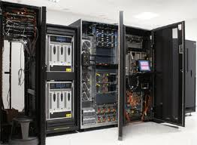
Mainframes
Chapter – 1 : Introduction to Computation

Slide 29
Super Computers
Fastest and expensive
Used by applications for molecular chemistry, nuclear research, weather reports, and advanced physics
Consists of several computers that work in parallel as a single system
Chapter – 1 : Introduction to Computation

Slide 30
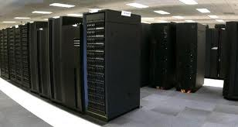
Super Computers
Chapter – 1 : Introduction to Computation

Slide 31
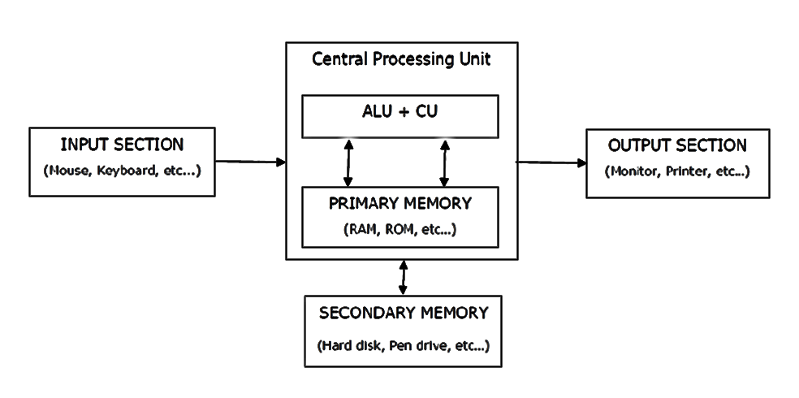
Components of Computer
Chapter – 1 : Introduction to Computation

Slide 32
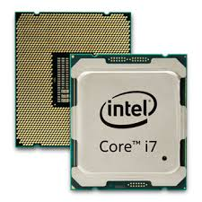
Central Processing Unit (CPU)
Brain of Computer
Electronic circuit that processes the data based on given instructions
Controls the flow of data
Chapter – 1 : Introduction to Computation

Slide 33
Central Processing Unit (CPU)
Has 3 parts:
  ALU Unit
  Control Unit
  Primary Memory
Chapter – 1 : Introduction to Computation

Slide 34
Input Devices
Devices used to enter data in computer system
Converts human understandable input to computer controllable data
Chapter – 1 : Introduction to Computation

Slide 35
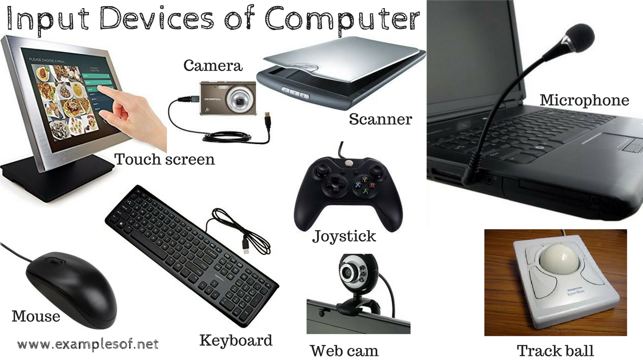
Input Devices
Chapter – 1 : Introduction to Computation

Slide 36
Output Devices
Devices used to send information to the outside world from computer
Converts data stored in 1’s and 0’s in computer to human readable form
Chapter – 1 : Introduction to Computation

Slide 37
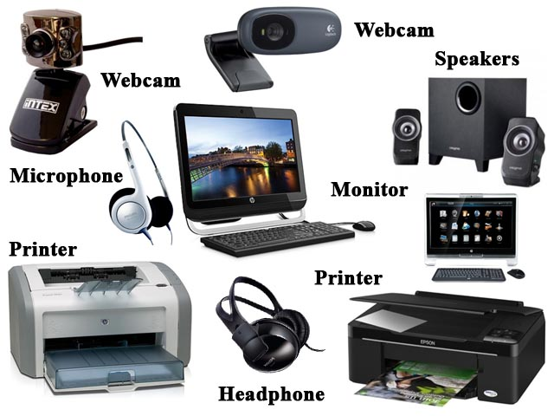
Output Devices
Chapter – 1 : Introduction to Computation

Slide 38
Storage Devices
Users can store data permanently
Also called as Auxiliary or External Memory
Can store large amount of data compared to primary memory as terabytes
Chapter – 1 : Introduction to Computation

Slide 39
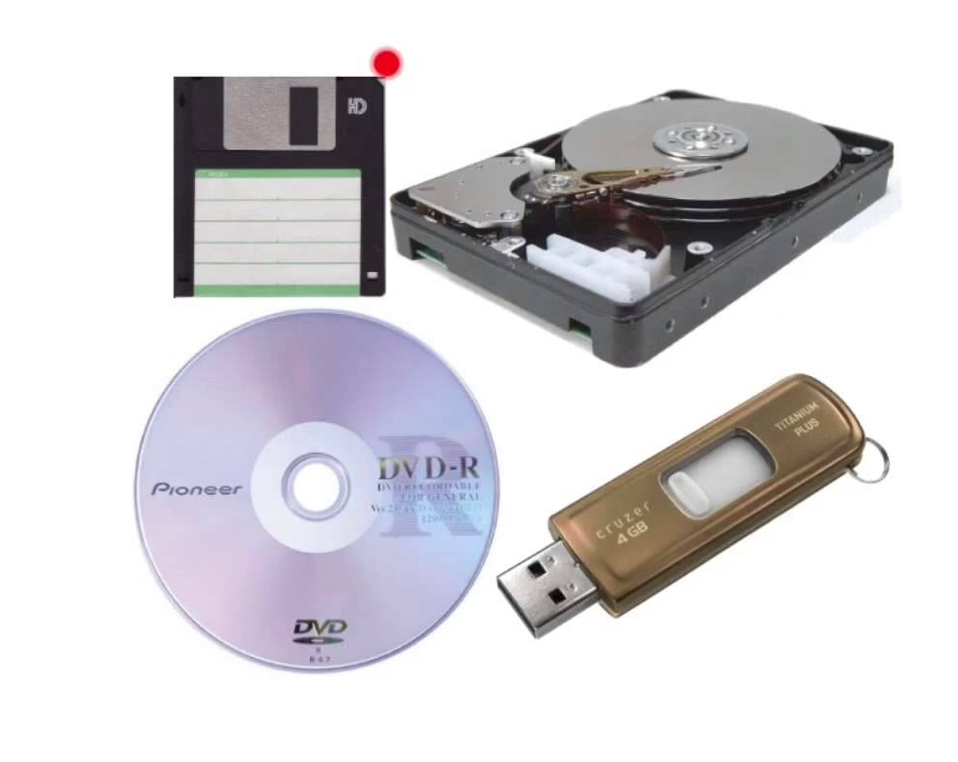
Storage Devices
Chapter – 1 : Introduction to Computation

Slide 40
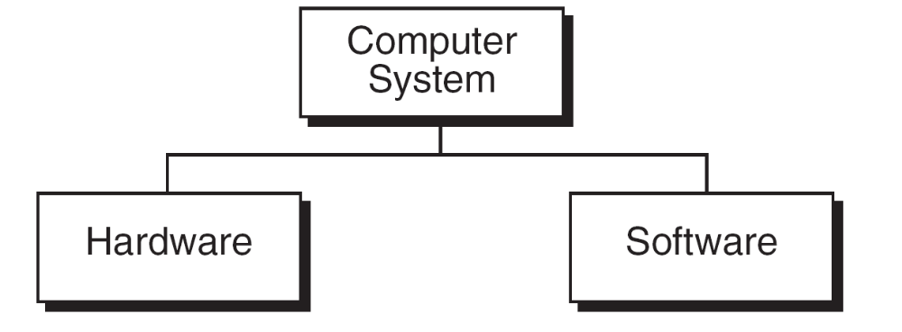
Hardware Vs. Software
Chapter – 1 : Introduction to Computation

Slide 41
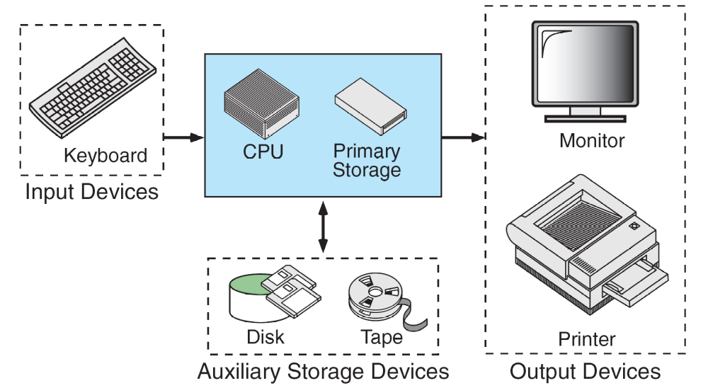
Basic Hardware Components
Chapter – 1 : Introduction to Computation

Slide 42
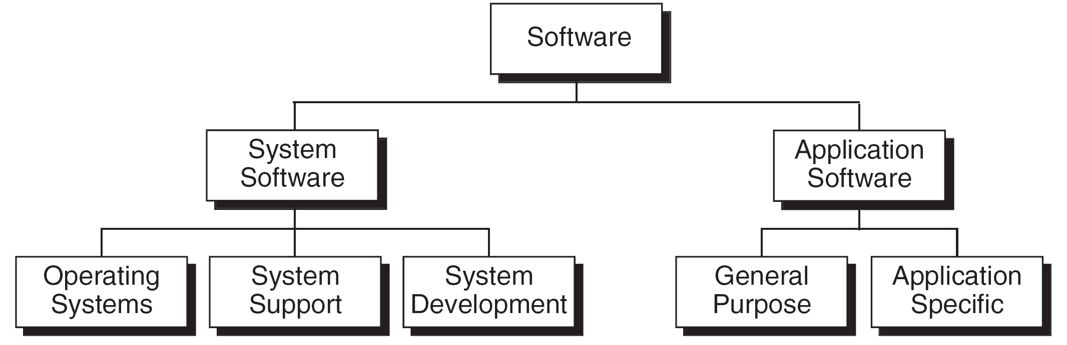
Types of Software
Chapter – 1 : Introduction to Computation

Slide 43
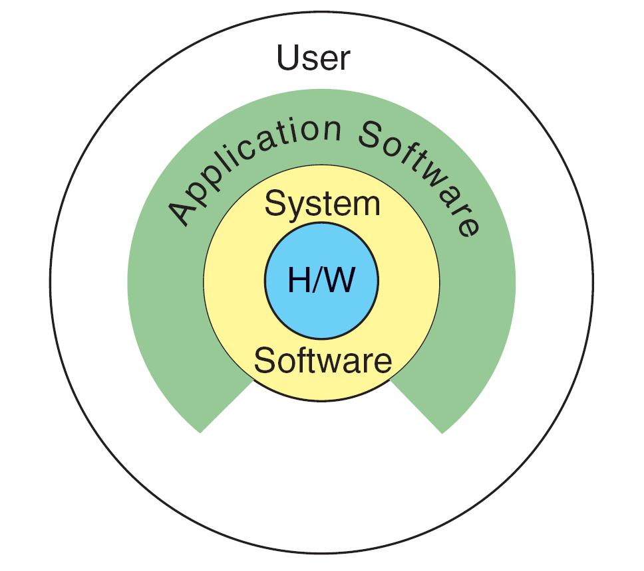
Relation between System & Application Software
Chapter – 1 : Introduction to Computation

Slide 44
Previous Year Questions
What are the different types of software?
State whether the following statements are TRUE or FALSE.
  (a) A compiler converts object code into source code.
Chapter – 1 : Introduction to Computation

Slide 45
